Slide 1
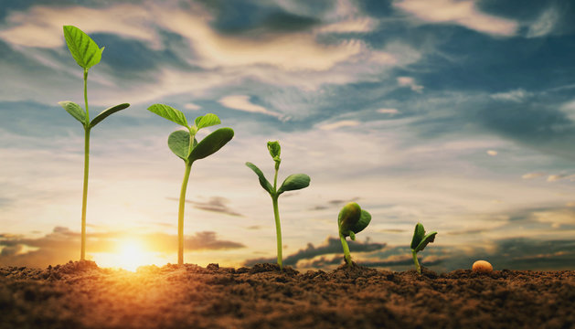
Welcome
To our
Presentation

Slide 2
Team Members:
Md Ruhul Amin(0242220005101245)
Shibbir Ahmad(0242220005101879)
Md Kamrul Islam(0242220005101155)
Instructor:
Angona Biswas
Lecturer
Department of CSE
Date: 16/11/2023

Slide 3
Introduction
Md Ruhul Amin
0242220005101245

Slide 4
Presentation Topic
Smart Agriculture Monitoring System

Slide 5
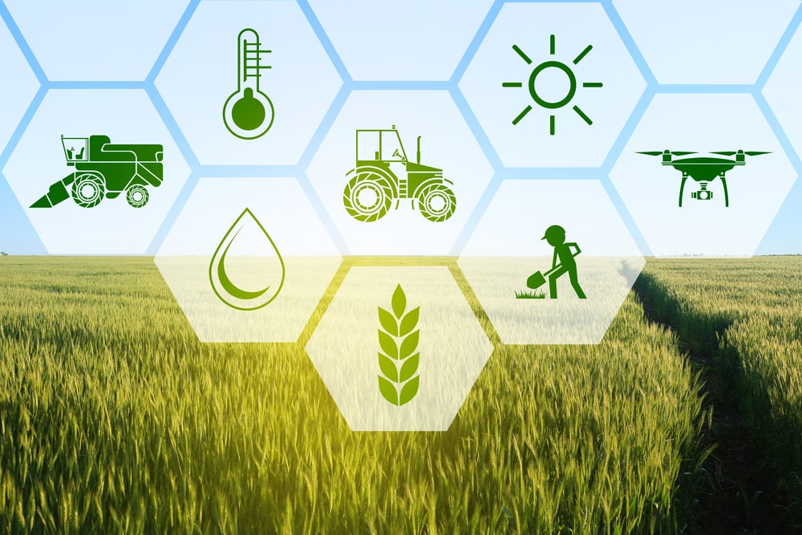
Introduction
Smart Agriculture Monitoring Systems utilize digital electronics to collect and analyze data in real-time.
These systems help farmers monitor crop health, soil moisture levels, and environmental conditions.
By leveraging digital technologies, farmers can make data-driven decisions to optimize crop yields and resource usage.

Slide 6
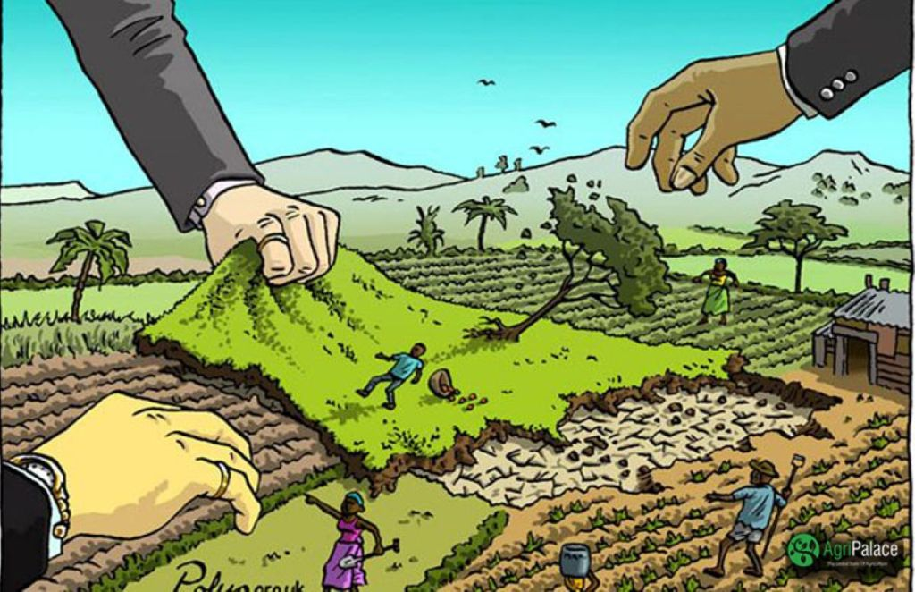
Concerns
Increasing population : Food is basic need of humankind. As the global population is increasing rapidly the demand of food is increasing as well. Agriculture needs to be more productive and efficient to keep pace with the rising demand for food.
Land shortage : with the growing population the agricultural land is now shrinking.
Strained resources : water scarcity is growing concern in this global warming age. Agriculture is a major water consumer. So sustainable consumption of water is essential.
Nutritional needs : for every human being balanced food consumption is import. To maintain this nutritional balance diet we need make our food production technique more efficient.

Slide 7
Technology & Example
Shibbir Ahmad
0242220005101879

Slide 8
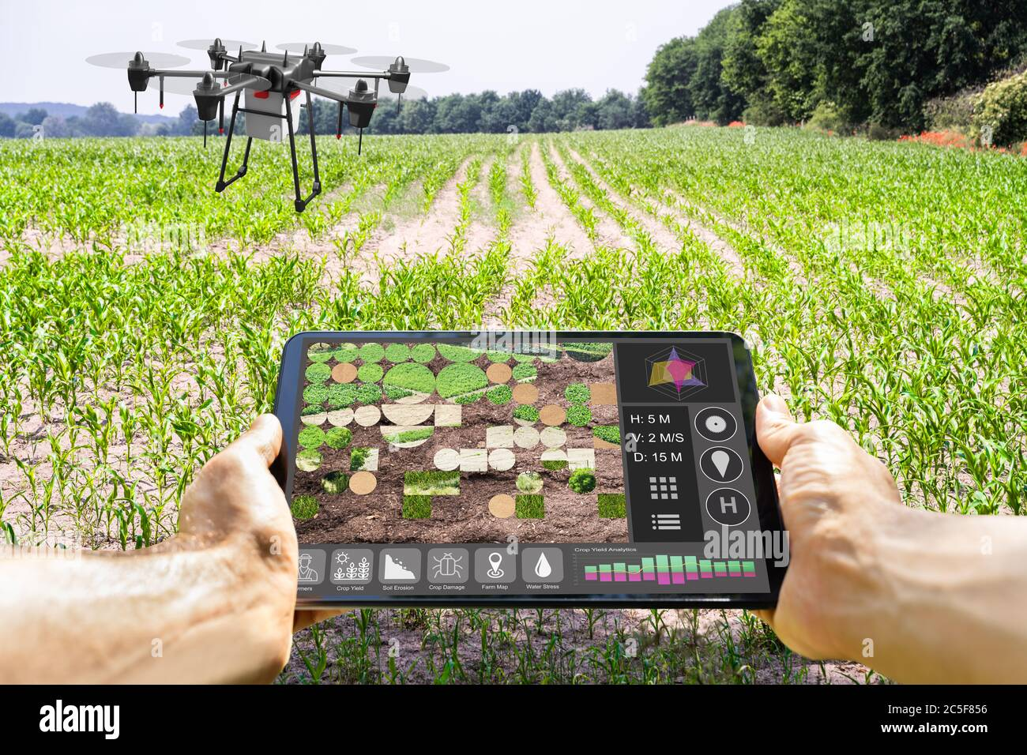
Technology
Smart farm and IoT-driven agriculture are laying the groundwork for a “third green revolution” which refers to the combined application of information and communications technologies. This includes devices such as precision equipment, IoT sensors and actuators, geo-positioning systems, Artificial Intelligence, unmanned aerial vehicles (UAVs) and robots.
Internet of Things
Information and communications technology
Artificial intelligence and machine learning
Automation and robotics

Slide 9
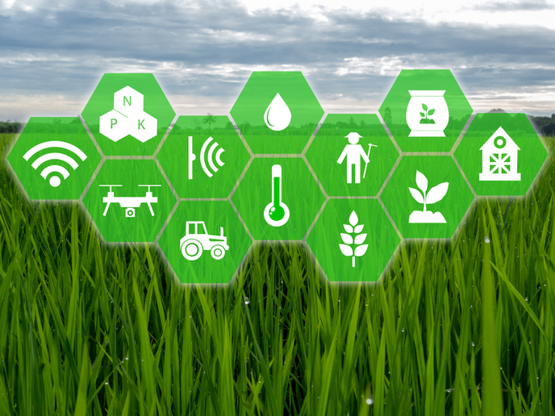
Example
Smart soil sensing for water optimization
In Texas, soil sensors sync with a smartphone app for real-time data on soil moisture, coupled with weather forecasts, empowering farmers with AI-driven watering recommendations for optimized crop growth in drought-prone regions.
AI-driven climate control in greenhouses
In Kazakhstan’s Almaty region, a five-hectare smart greenhouse facility is equipped with IoT technology and AI. These technologies monitor conditions within the greenhouses and automatically adjust temperatures, light, humidity and irrigation levels as necessary to create the optimal environment for crop growth.

Slide 10
Benefits, Importance & Conclusion
Md Kamrul Islam
0242220005101155

Slide 11
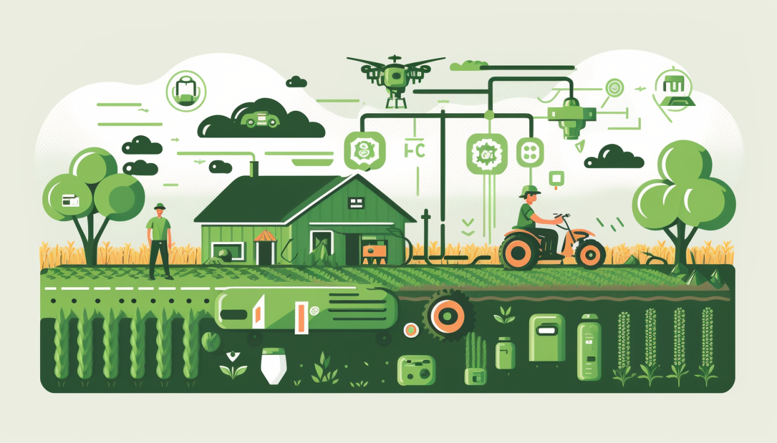
Benefits
Increased efficiency through real-time monitoring and automated control of irrigation systems.
Enhanced crop quality and yield by optimizing resource usage based on data-driven insights.
Reduced labor costs and environmental impact through precise application of fertilizers and pesticides.

Slide 12
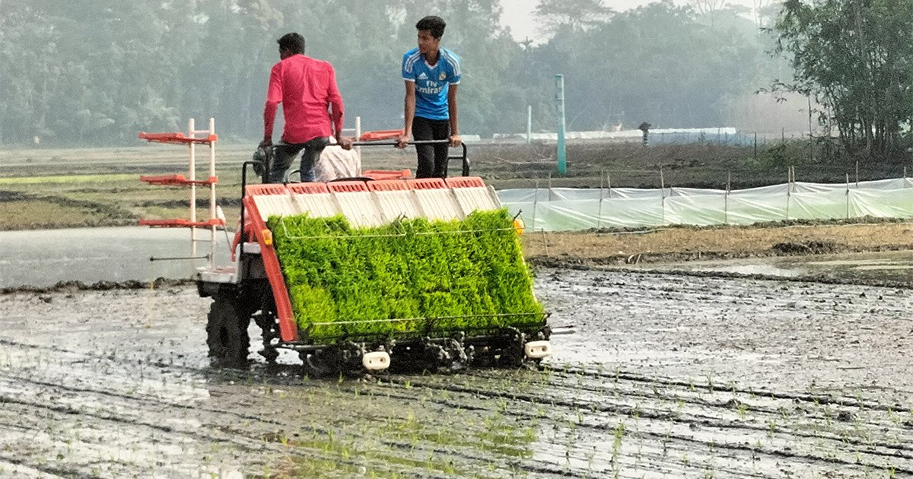
Importance in Bangladesh
Smart agriculture monitoring systems hold particular significance for Bangladesh due to several factors:
Climate Vulnerability:
• Flood warnings: Water level sensors can trigger alerts for impending floods, allowing farmers to take steps to protect crops and livestock.
• Drought monitoring: Soil moisture sensors can help farmers identify dry spells and adjust irrigation practices to conserve water.

Slide 13

Water Scarcity:
• Precision irrigation: By monitoring soil moisture, these systems ensure crops receive only the water they need, reducing water waste.
Conclusion: Smart agriculture monitoring systems can significantly improve agricultural practices in Bangladesh. They offer solutions for climate challenges, water scarcity, limited land, and empower smallholder farmers. With government support and continuous development, these systems have the potential to transform Bangladesh's agricultural sector, leading to increased efficiency, sustainability, and overall agricultural success.

Slide 14

Any Question?

Slide 15
Thank You

